Slide 1
The Scala Programming Language
Original Slides
Donna Malayeri

Slide 2
Java fibonocci
import java.math.BigInteger;
public class FiboJava {
private static BigInteger fibo(int x) {
BigInteger a = BigInteger.ZERO;
BigInteger b = BigInteger.ONE;
BigInteger c = BigInteger.ZERO;
for (int i = 0; i < x; i++) {
c = a.add(b); a = b; b = c; }
return a; }
public static void main(String args[]) { System.out.println(fibo(1000)); } }

Slide 3
Scala fibonacci
object FiboScala extends App {
def fibo(x: Int): BigInt = {
var a: BigInt = 0
var b: BigInt = 1
var c: BigInt = 0
for (_ <- 1 to x) {
c = a + b a = b b = c }
return a }
println(fibo(1000)) }

Slide 4
Scala functional fibonacci
object FiboFunctional extends App {
val fibs:Stream[BigInt] =
0 #::
1 #::
(fibs zip fibs.tail).map{ case (a,b) => a+b }
println(fibs(1000)) }

Slide 5
Qsort in Scala
def qsort: List[Int] => List[Int] = {
case Nil => Nil
case pivot :: tail =>
val (smaller, rest) = tail.partition(_ < pivot)
qsort(smaller) :: pivot :: qsort(rest)
}

Slide 6
Higher Order Functions
def apply(f: Int => String, v: Int) = f(v)
class Decorator(left: String, right: String) {
def layout[A](x: A) = left + x.toString() + right
}
object FunTest extends Application {
def apply(f: Int => String, v: Int) = f(v)
val decorator = new Decorator("[", "]") println(apply(decorator.layout, 7)) }

Slide 7
Why a new language?
Goal was to create a language with better support for component software
Two hypotheses:
  Programming language for component software should be scalable
    The same concepts describe small and large parts
    Rather than adding lots of primitives, focus is on abstraction, composition, and decomposition
  Language that unifies OOP and functional programming can provide scalable support for components
Adoption is key for testing this hypothesis
  Scala interoperates with Java and .NET

Slide 8
Features of Scala
Scala is both functional and object-oriented
  every value is an object
  every function is a value--including methods
Scala is statically typed
  includes a local type inference system

Slide 9
More features
Supports lightweight syntax for anonymous functions, higher-order functions, nested functions, currying
ML-style pattern matching
Integration with XML
  can write XML directly in Scala program
  can convert XML DTD into Scala class definitions
Support for regular expression patterns

Slide 10
Other features
Allows defining new control structures without using macros, and while maintaining static typing
Any function can be used as an infix or postfix operator
Can define methods named +, <= or ::

Slide 11
Automatic Closure Construction
Allows programmers to make their own control structures
Can tag the parameters of methods with the modifier def
When method is called, the actual def parameters are not evaluated and a no-argument function is passed

Slide 12
While loop example
object TargetTest1 with Application {
def loopWhile(def cond: Boolean)(def body: Unit): Unit =
if (cond) {
body;
loopWhile(cond)(body)
}
var i = 10;
loopWhile (i > 0) {
Console.println(i);
i = i - 1
}
}
Define loopWhile method
Use it with nice syntax

Slide 13
Lazy Values
case class Employee(id: Int,
name: String,
managerId: Int) {
val manager: Employee = Db.get(managerId)
val team: List[Employee] = Db.team(id)
case class Employee(id: Int,
name: String,
managerId: Int) {
lazy val manager: Employee = Db.get(managerId)
lazy val team: List[Employee] = Db.team(id)
}

Slide 14
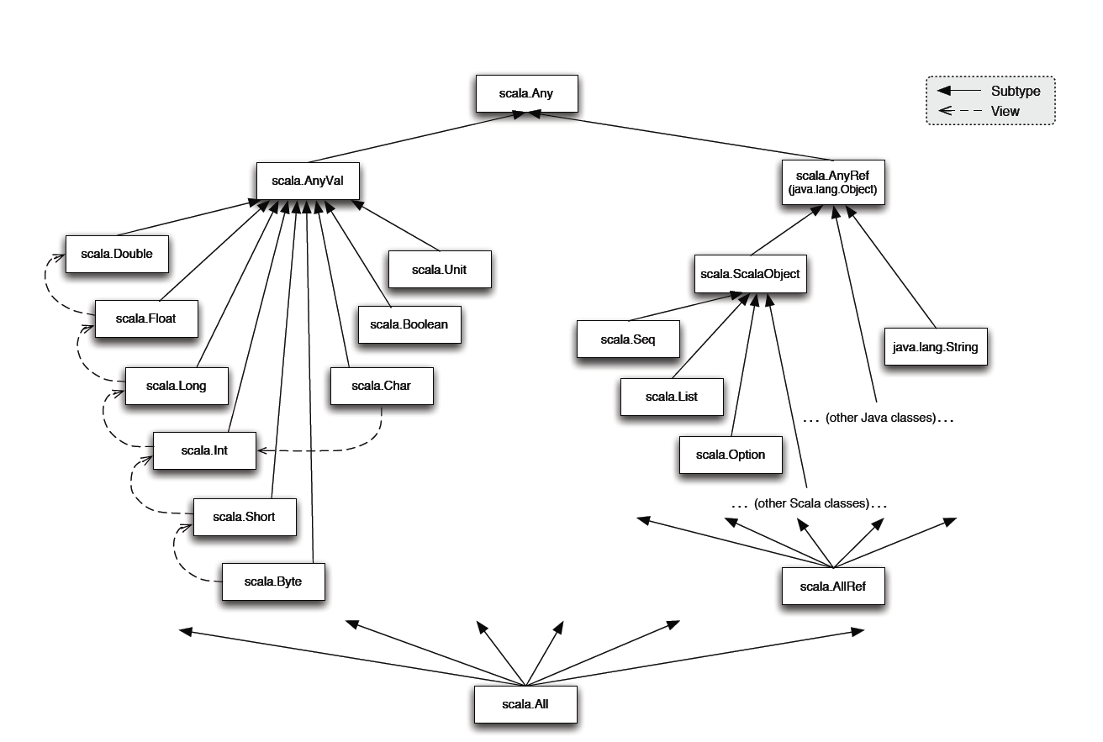
Scala class hierarchy

Slide 15
Scala object system
Class-based
Single inheritance
Can define singleton objects easily
Subtyping is nominal
Traits, compound types, mixin, and views allow for more flexibility
Notes:
Since traits do not encapsulate state, inheriting twice from a trait is legal in Scala.

Slide 16
Classes and Objects
  trait Nat;
  object Zero extends Nat {
  def isZero: boolean = true;
  def pred: Nat =
  throw new Error("Zero.pred");
  }
  class Succ(n: Nat) extends Nat {
  def isZero: boolean = false;
  def pred: Nat = n;
  }
Notes:
Traits are similar to interfaces in Java.
Nat defines a trait that’s just a placeholder. Zero has only one instance, so it’s an object rather than a class.

Slide 17
Traits
Similar to interfaces in Java
They may have implementations of methods
But can’t contain state
Can be multiply inherited from

Slide 18
Example of traits
trait Similarity {
def isSimilar(x: Any): Boolean;
def isNotSimilar(x: Any): Boolean = !isSimilar(x);
}
class Point(xc: Int, yc: Int) with Similarity {
var x: Int = xc;
var y: Int = yc;
def isSimilar(obj: Any) =
obj.isInstanceOf[Point] &&
obj.asInstanceOf[Point].x == x;
}
Notes:
Traits can have code, unlike Java interfaces, but can’t have any state associated with them.
Scala allows multiple inheritance of traits

Slide 19
Views
Defines a coercion from one type to another
Similar to conversion operators in C++/C#
  trait Set {
  def include(x: int): Set;
  def contains(x: int): boolean
  }
  def view(list: List) : Set = new Set {
  def include(x: int): Set = x prepend xs;
  def contains(x: int): boolean =
  !isEmpty &&
  (list.head == x || list.tail contains x)
  }

Slide 20
Views
Views are inserted automatically by the Scala compiler
If e is of type T then a view is applied to e if:
  expected type of e is not T (or a supertype)
  a member selected from e is not a member of T
Compiler uses only views in scope
Suppose xs : List and view above is in scope
val s: Set = xs;
xs contains x
val s: Set = view(xs);
view(xs) contains x
Notes:
Note that changes to the result returned by ‘view’ are not reflected in the original function.

Slide 21
Variance annotations
class Array[a] {
def get(index: int): a
def set(index: int, elem: a): unit;
}
Array[String] is not a subtype of Array[Any]
If it were, we could do this:
val x = new Array[String](1);
val y : Array[Any] = x;
y.set(0, new FooBar());
// just stored a FooBar in a String array!

Slide 22
Variance Annotations
Covariance is ok with functional data structures
trait GenList[+T] {
def isEmpty: boolean;
def head: T;
def tail: GenList[T]
}
object Empty extends GenList[All] {
def isEmpty: boolean = true;
def head: All = throw new Error("Empty.head");
def tail: List[All] = throw new Error("Empty.tail");
}
class Cons[+T](x: T, xs: GenList[T]) extends GenList[T] {
def isEmpty: boolean = false;
def head: T = x;
def tail: GenList[T] = xs
}

Slide 23
Variance Annotations
Can also have contravariant type parameters
  Useful for an object that can only be written to
Scala checks that variance annotations are sound
  covariant positions: immutable field types, method results
  contravariant: method argument types
  Type system ensures that covariant parameters are only used covariant positions
  (similar for contravariant)

Slide 24
Types as members
abstract class AbsCell {
type T;
val init: T;
private var value: T = init;
def get: T = value;
def set(x: T): unit = { value = x }
}
def createCell : AbsCell {
new AbsCell { type T = int; val init = 1 }
}
Clients of createCell cannot rely on the fact that T is int, since this information is hidden from them

Slide 25
Sumary
Scala is a very regular language when it comes to composition:
Everything can be nested:
  classes, methods, objects, types
Everything can be abstract:
  methods, values, types
The type of this can be declared freely, can thus express dependencies
This gives great flexibility for SW architecture, allows us to attack previously unsolvable problems

Slide 26
Going further: Parallel DSLs
Mid term, research project: How do we keep tomorrow’s computers loaded?
  How to find and deal with 10000+ threads in an application?
  Parallel collections and actors are necessary but not sufficient for this.
Our bet for the mid term future: parallel embedded DSLs
  Find parallelism in domains: physics simulation, machine learning, statistics, ...
Joint work with Kunle Olukuton, Pat Hanrahan @ Stanford

Slide 27













EPFL / Stanford Research
Applications
Scientific
Engineering
Virtual Worlds
Personal Robotics
Data
informatics
Domain
Specific
Languages
Rendering
Physics
(Liszt)
Scripting
Probabilistic
(RandomT)
Machine Learning
(OptiML)
Domain Embedding Language (Scala)
DSL
Infrastructure
Polymorphic Embedding
Staging
Static Domain Specific Opt.
Parallel Runtime (Delite, Sequoia, GRAMPS)
Dynamic Domain Spec. Opt.
Task & Data Parallelism
Locality Aware Scheduling
Hardware Architecture
Heterogeneous
Hardware
OOO Cores
SIMD Cores
Threaded Cores
Specialized Cores
Programmable
Hierarchies
Scalable
Coherence
Isolation & Atomicity
On-chip
Networks
Pervasive Monitoring
Notes:
This leads to our vision, applications driven by a set of interoperable DSLs. We are developing DSLs to provide evidence as to their effectiveness in extracting parallel performance. But we are also very interested in empowering other to easily build such DSLs, so we are investing heavily in developing frameworks and runtimes to make parallel DSL development easier. And the goal is to run single source programs on a variety of very different hardware targets.

Slide 28

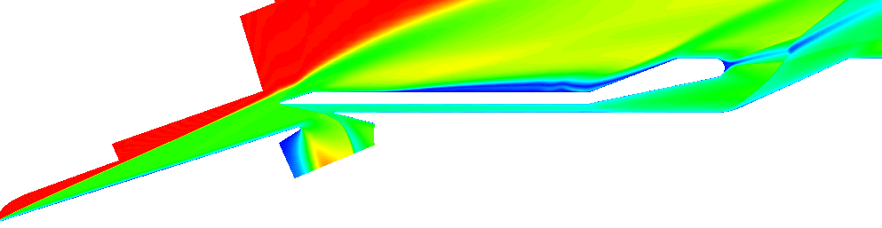
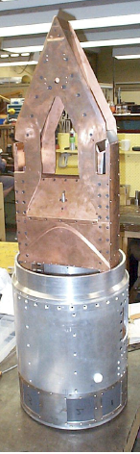
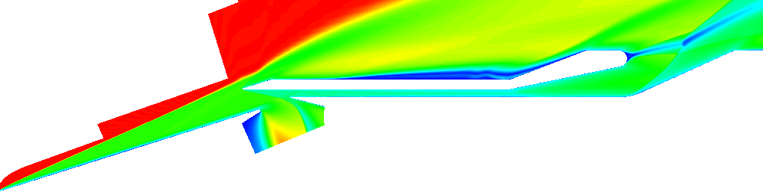
Example: Liszt - A DSL for Physics Simulation
Combustion
Turbulence
Fuel injection
Transition
Thermal
Mesh-based
Numeric Simulation
Huge domains
  millions of cells
Example: Unstructured Reynolds-averaged Navier Stokes (RANS) solver
Turbulence
Notes:
Liszt is another language we have implemented. It is designed to support the creation of solvers for mesh-based partial differential equations. Problems in this domain typically simulate complex physical systems such as fluid flow or mechanics by breaking up space into discrete cells. A typical mesh may contain hundreds of millions of these cells (here we are visualizing a scram-jet designed to work at hypersonic speeds). Liszt is an ideal candidate for a DSL because while the problems are large and highly parallel, the mesh introduces many data-dependencies that are difficult to reason about, making writing solvers tedious.

Slide 29
Liszt as Virtualized Scala
val // calculating scalar convection (Liszt)
val Flux = new Field[Cell,Float]
val Phi = new Field[Cell,Float]
val cell_volume = new Field[Cell,Float]
val deltat = .001
...
untilconverged {
for(f <- interior_faces) {
val flux = calc_flux(f)
Flux(inside(f)) -= flux
Flux(outside(f)) += flux
}
for(f <- inlet_faces) {
Flux(outside(f)) += calc_boundary_flux(f)
}
for(c <- cells(mesh)) {
Phi(c) += deltat * Flux(c) /cell_volume(c)
}
for(f <- faces(mesh))
Flux(f) = 0.f
}
AST
Optimisers Generators
…
Schedulers
…
Hardware
DSL Library
GPU, Multi-Core, etc

